Slide 1
Notification system OF spam free ads FOR craigslist
TEAM BCG
Deepika Jindal
Juilee Bhosale
Shubham Gupta
Vijaya Rani
Yuvraj Gupta
Notes:
1

Slide 2

Online Advertisement market is growing

Slide 3

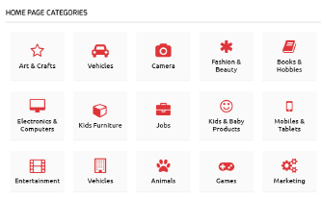

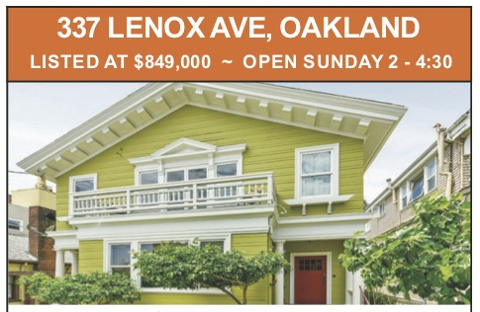

Slide 4
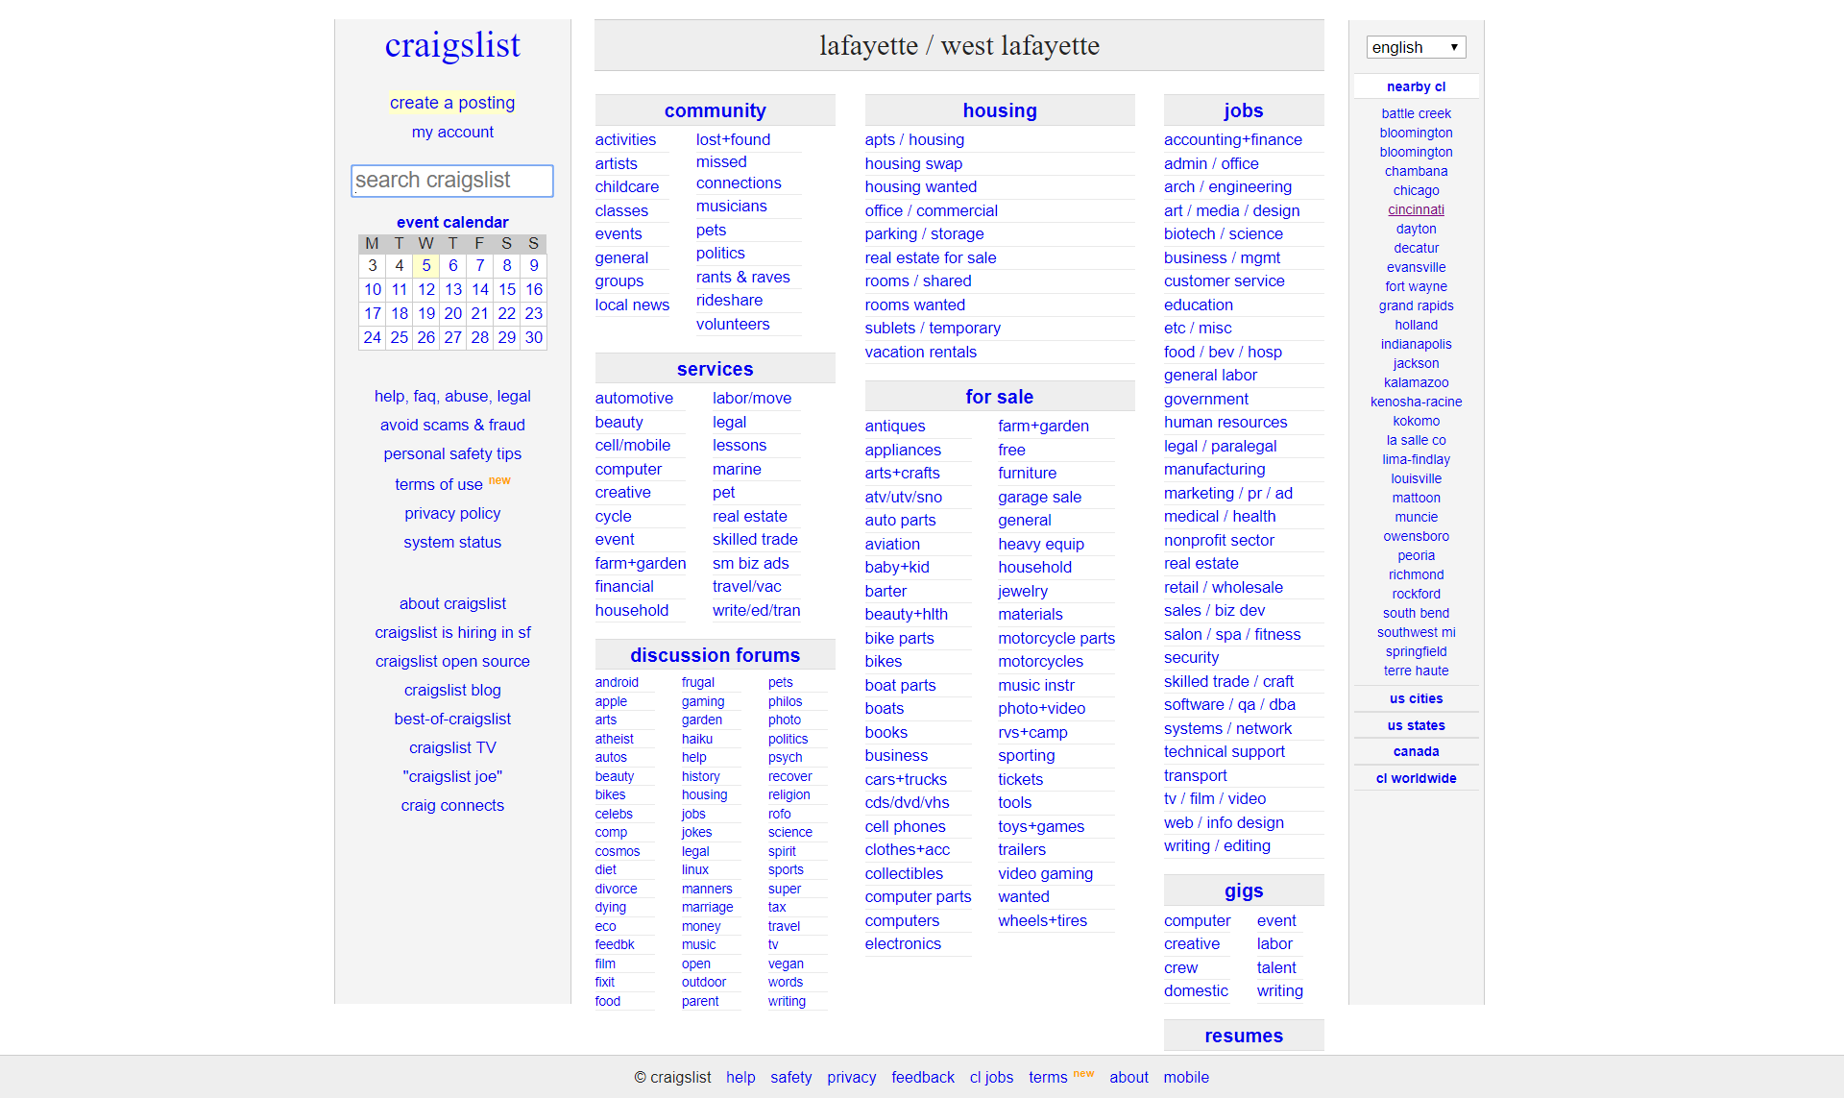
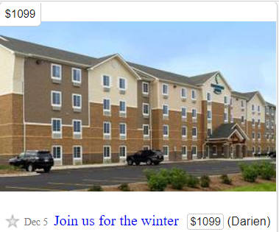
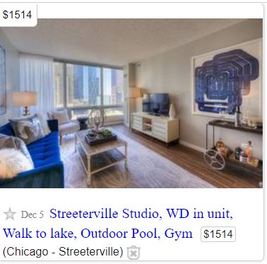

Slide 5
Rental is an in-demand sub-section in craigslist
Craigslist has become the single largest information exchange about rental housing market in the USA
The average American will move 11.4 times in their lives
Millions of new listings are added monthly

Slide 6
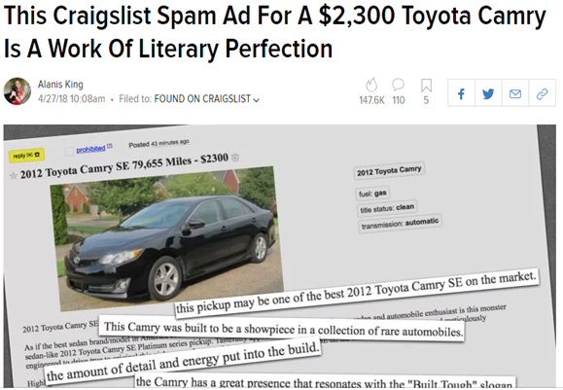
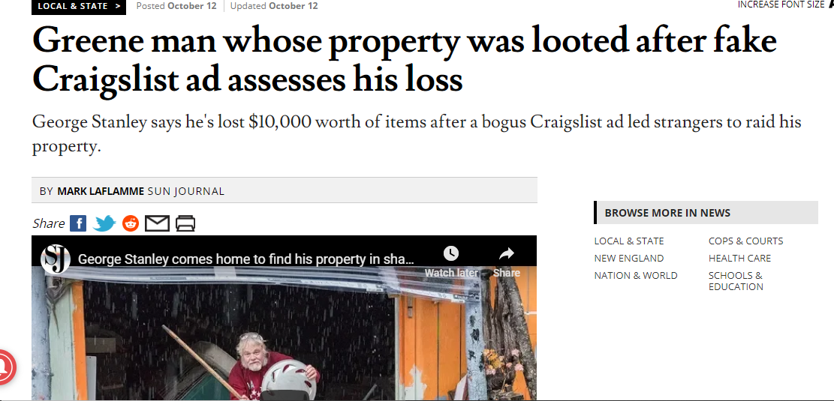
You can be the next victim!!!
You can be the next victim

Slide 7
There are A lot of problems unsolved
Selection from thousands of existing listings is a task
Millions of ads are posted anonymously of which, 6% of the housing classified ads are fraud.
User spend hours finding legitimate ads
High volumes of rental scams damages the reputation of Craigslist & increases user drop-off rates
Fraud in Craigslist rental SO HIGH - considering charging a fee for its ads
Notes:
Automation of most relevant selection of spam-free ads
Reduce time of users to find legitimate ads from hours to mins
Enhance the reliability & reputation of craigslist
One-stop solution to find spam-free ads
Increase customer satisfaction

Slide 8

Objective of building our solution
Build a notification system to show spam free ads for housing rentals
Robust model for fraud ad detection to ensure safety of users
Automatically notify users about new listings as per the keywords specified

Slide 9
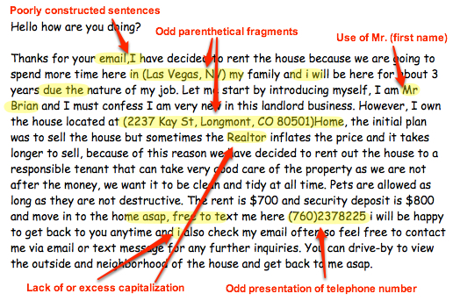
ways to identify a fraud ad

Slide 10
A simplistic approach for the solution
Scrape housing listings as per the keyword
Run trained model to remove fake-ads
Send automated email of newly listed relevant ads on a daily basis
Send user an email of relevant spam-free listings
User enters a keyword

Slide 11
Step by step process OF modelling the solution
Scraping
Marking spam ads
Scraping Data for search criteria
Training classification Model
Identifying spam ads based on Training Model
Remove spam ads
Identifying Spam Ads
Getting Search Criteria Data
Notify
Identify new ads from legitimate ads
Notify user

Slide 12
Stacking ensemble model is the best!!!
We tested various classification models and selected best model based on best classification metrics
Classification models explored
Logistic regression
Random Forest
K-Nearest Neighbors
Gradient Boosting
Naïve Bayes classifier
Support Vector Machine
Classification Parameters used for selection of models
Entropy
AUC
Precision (Specificity)
F-measure
GINI impurity
A stacking ensemble model, which implemented a combination of these models, was used to make the final spam predictions
Notes:
Model with the highest precision or specificity is selected as false negatives (spam goes to the inbox) are more acceptable than false positives (non-spam is caught by the spam filter)

Slide 13
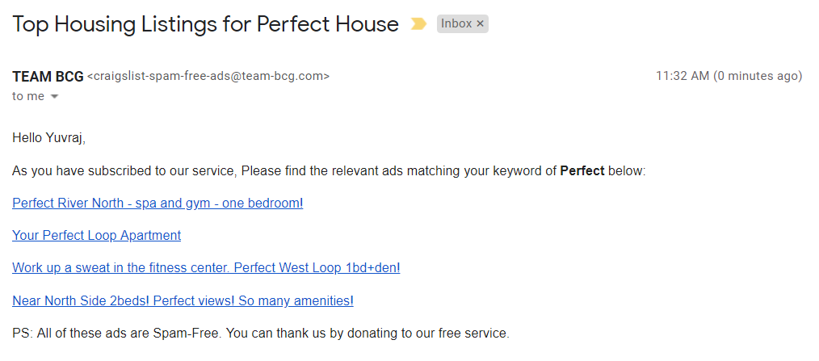
notification MAIL sent to user

Slide 14



Our project adds value to craigslist & IT’s Users
Craigslist
Say No to Frauds
Building Loyal Customer Base
Enhance Customer Life-time Value
Enhance the reliability & reputation
User
User safety and Risk mitigation
Narrowing down the selection
Reduce time of users to find legitimate ads from hours to mins
Automated Notification of relevant set of spam-free ads
Increase customer satisfaction
Added Value
One-stop solution to find spam-free ads
Competitive Advantage

Slide 15
Future scope
Future enhancements
Price Outliers
Expansion to other countries
Extraction of phone numbers
Breaking location down by neighborhood
Notes:
Identifying price outliers and calculating whether a post falls within a normal range based on its location
Text based classifications such as number of (or percentage of) upper case letters, special characters, and length of text

Slide 16


